Slide 1
Epicollect practical: CPE outbreak investigation
Dr Francesc Coll
IBV-CSIC, Valencia, Spain

Slide 2
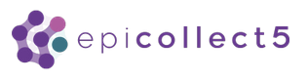

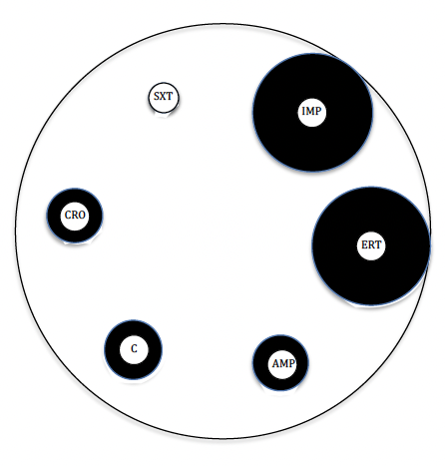
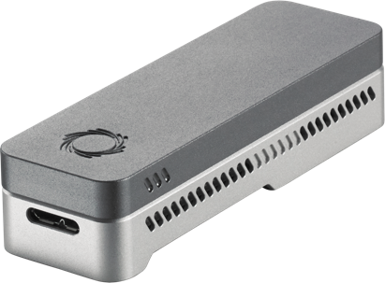
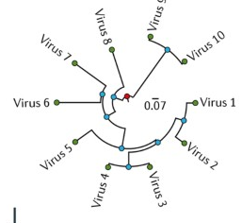

Sample collection
Phenotypic AST
WGS and QC
Genotypic AST
Phylogenetic analyses
Data integration
Metadata design and collection
Isolation, culture, disc diffusion
Illumina & ONT, genomic QC
AMR bioinformatic detection and metagenomics
Alignment and variant calling, phylogenetic reconstruction
Epicollect, Microreact
Epicollect

Slide 3
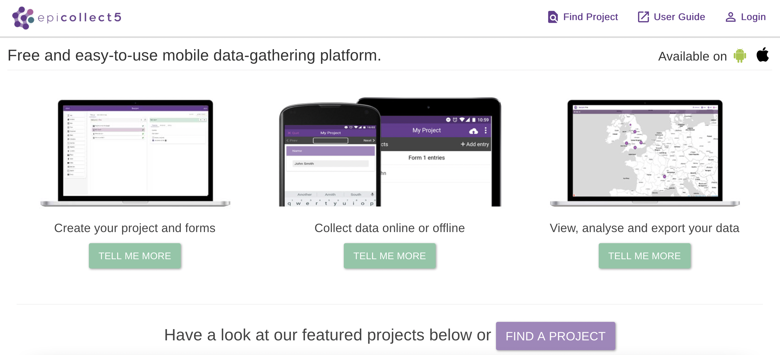
Introduction to Epicollect and practical
https://five.epicollect.net/

Slide 4
Epicollect exercise case Information sheet
Basic sample, demographic and epidemiological data
Species, strain typing info
→ to be introduced later this week
AMR phenotype and genotype data
→ to be introduced later this week
Introduction to Epicollect and practical

Slide 5
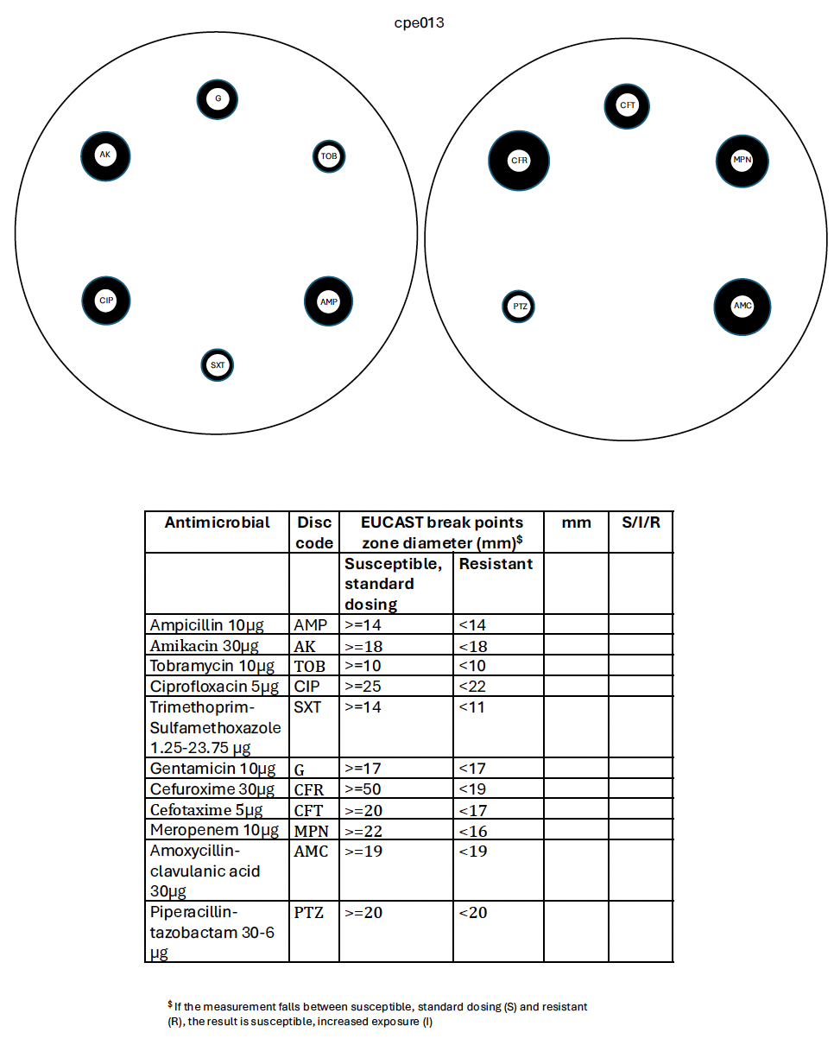
Later on in the course
Disk diffusion plates
Interpretation of disk diameters
→ Available for 17 Klebsiella pneumoniae

Slide 6
EpiCollect exercise groups
Group 1 (n=8) Group 2 (n=8) Group 3 (n=8)
Bawa Boya |  | Tesfay Abreha Nigusse |  | Palesa Khotso
Mapeesho Kamayani |  | Rungano Magadu |  | Nelson Malugu
Winnifred Akello |  | Charles Ogu |  | Alimatou Héma
Purity Oreng' |  | Kelvin ZIngwangwa |  | Nigusu Berhanu Kassaye
Drake Byamukama |  | Ihssane Benzaarate |  | Anélsio Cossa
Lovina Ikwe |  | Mwamba Nsofwa |  | Loide Nangolo
Sulaiman Hassan |  | Rita Ohene Larbi |  | Cheickna Dicko
Deborah Jideani |  | Balungile Shezi |  | Clifford Menzi Tshuma

Slide 7


- Download and Install EpiCollect 5 on your phone
- Turn on the location (GPS) in your phone
- Turn on WIFI too
- Connect to the network using the provided WIFI credentials

Slide 8
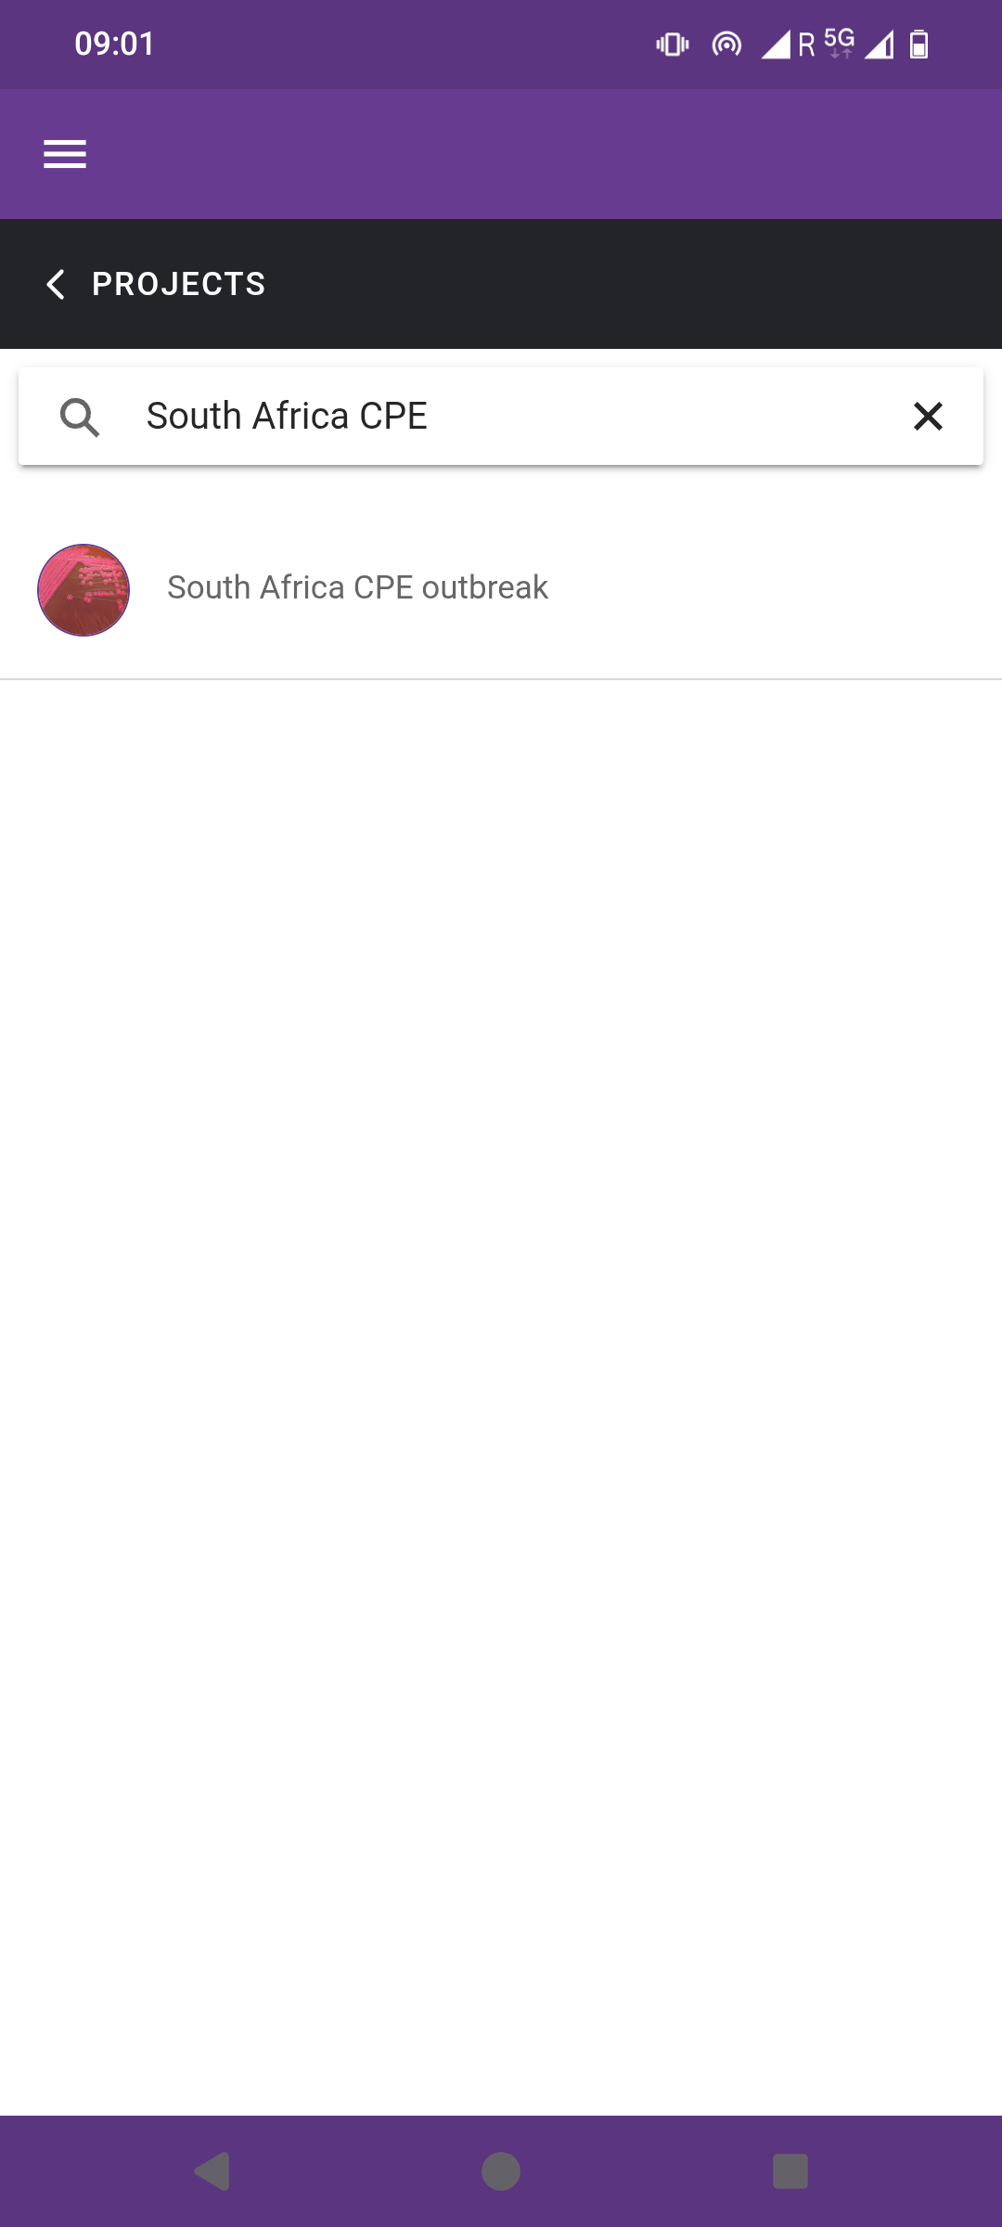
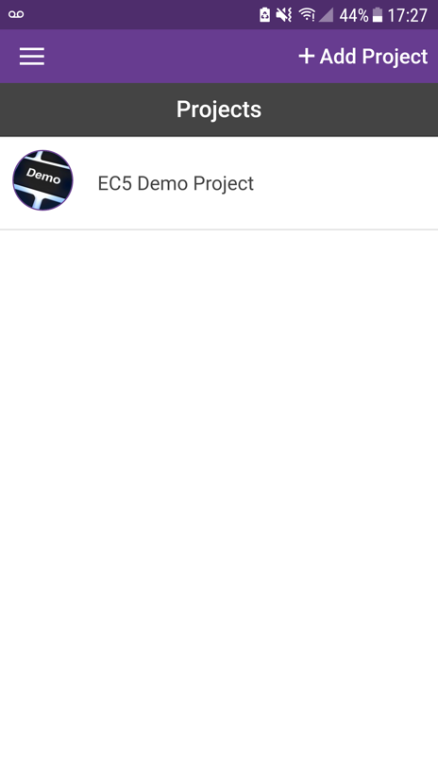
- Open the EpiCollect5 app. If you do not find the ‘South Africa CPE’ project, click on ‘Add Project’ to search for it.
Notes:
- Add screenshot with location: make sure accuracy is 25m or less (different phones seem to have different accuracies)

Slide 9
- Go to your assigned site and pick up a case Information sheet.
Remember to take your paper sheet and keep it throughout the week, as you will be introducing later information into Epicollect

Slide 10
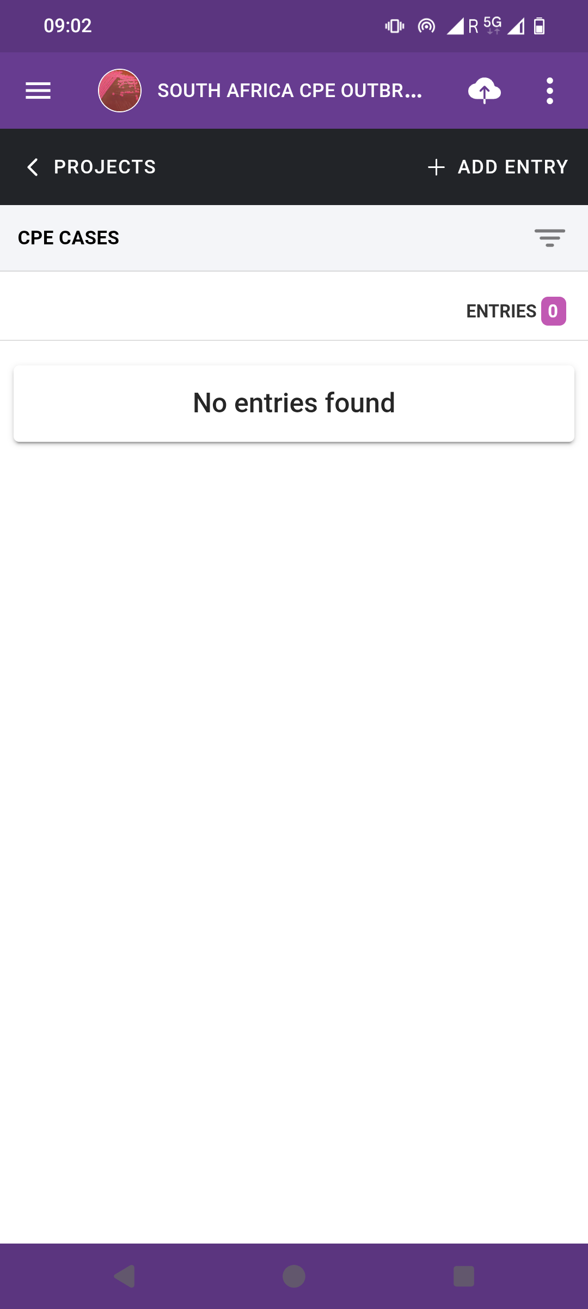
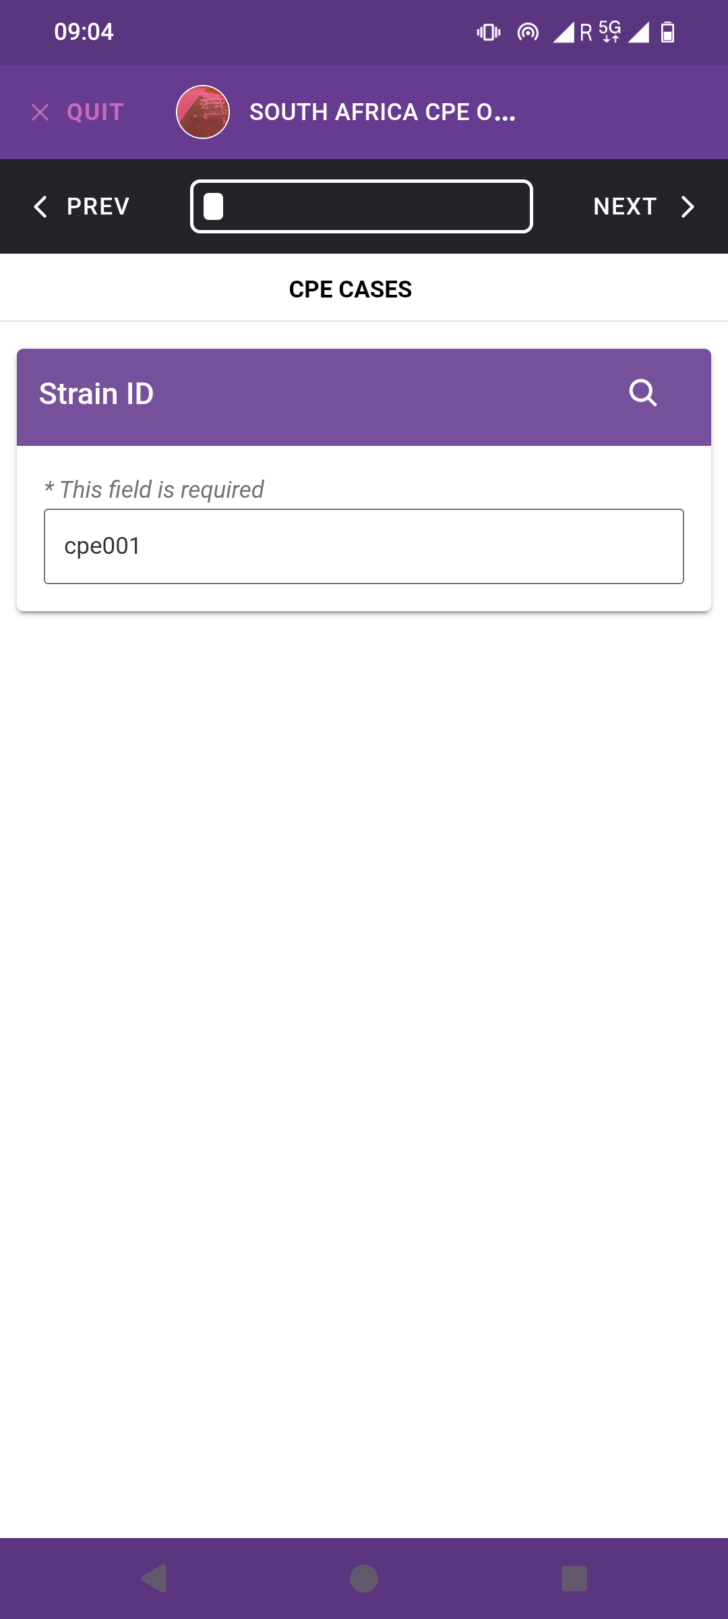
- Select ‘+Add entry’ and fill in all required fields. Click on ’Next’ to go to the next field.

Slide 11
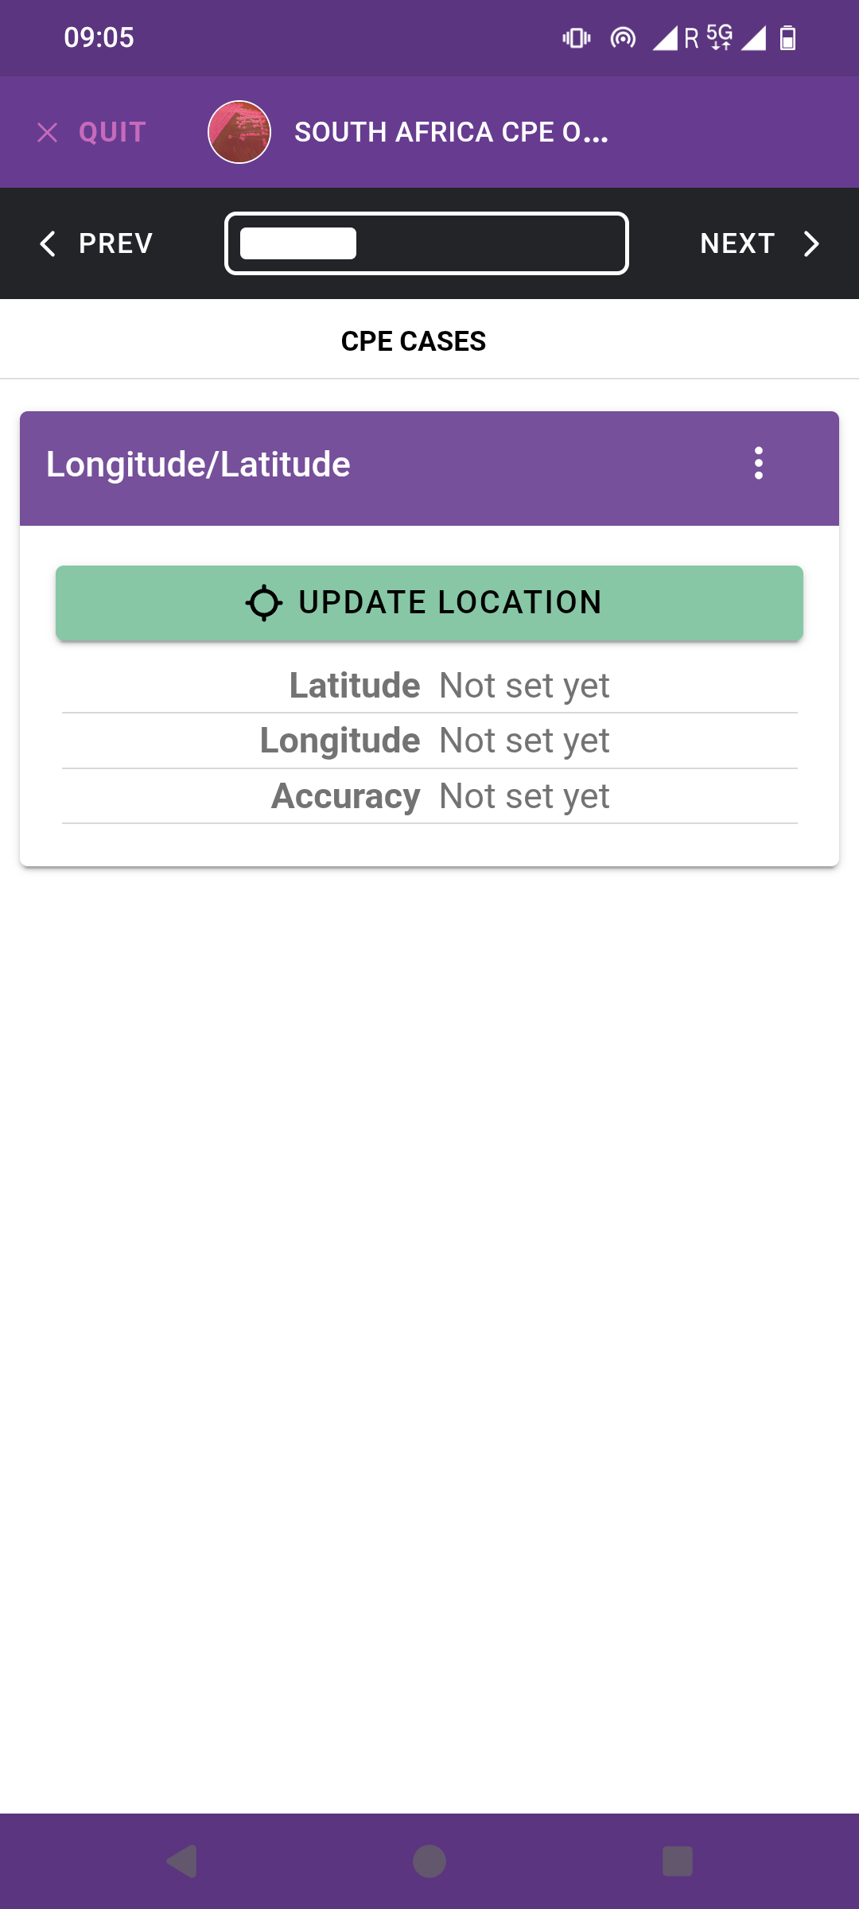
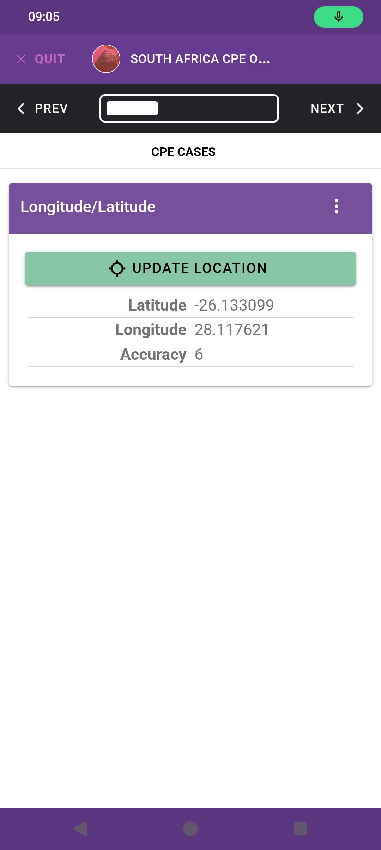
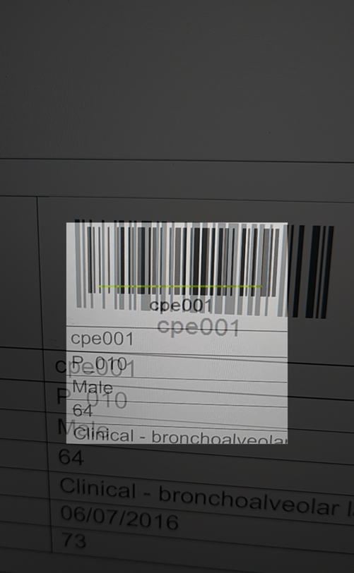
- Scan the barcode on your sheet. Click on ‘Update location’ several times until the accuracy is good (under 10 meters or similar).

Slide 12
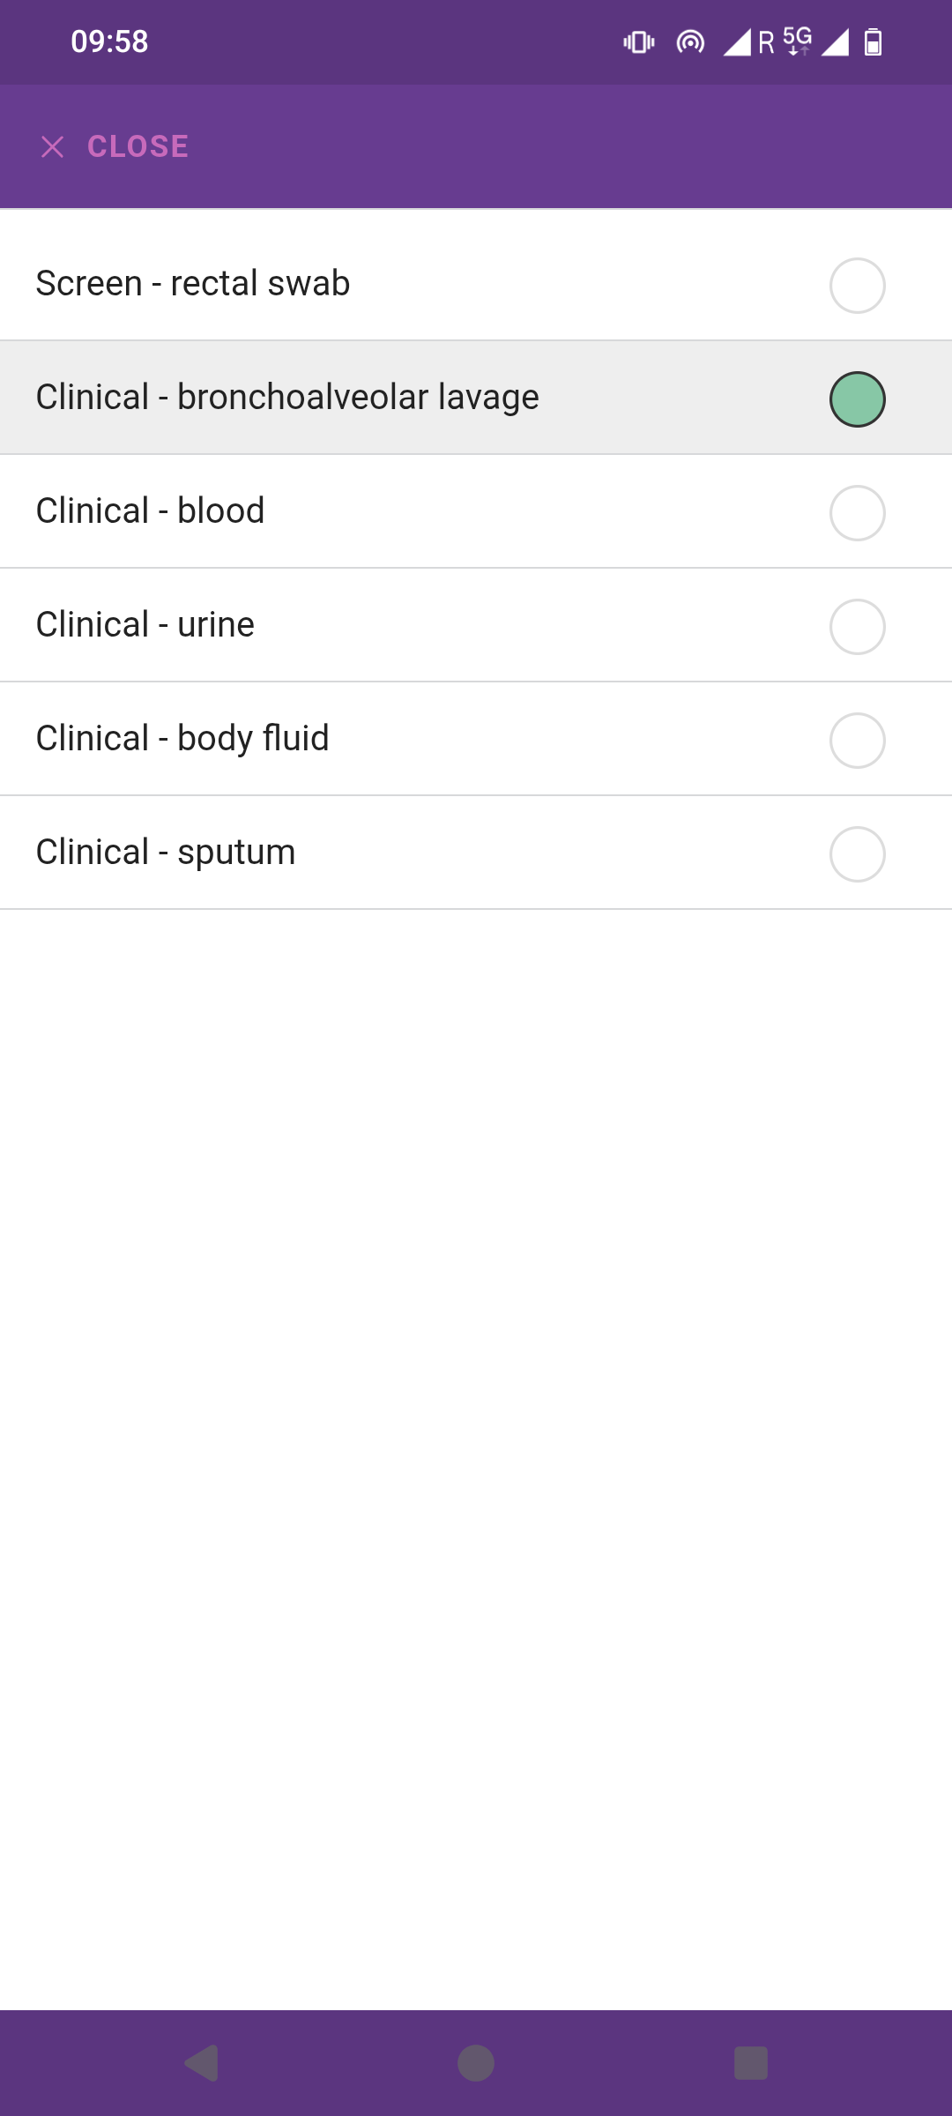
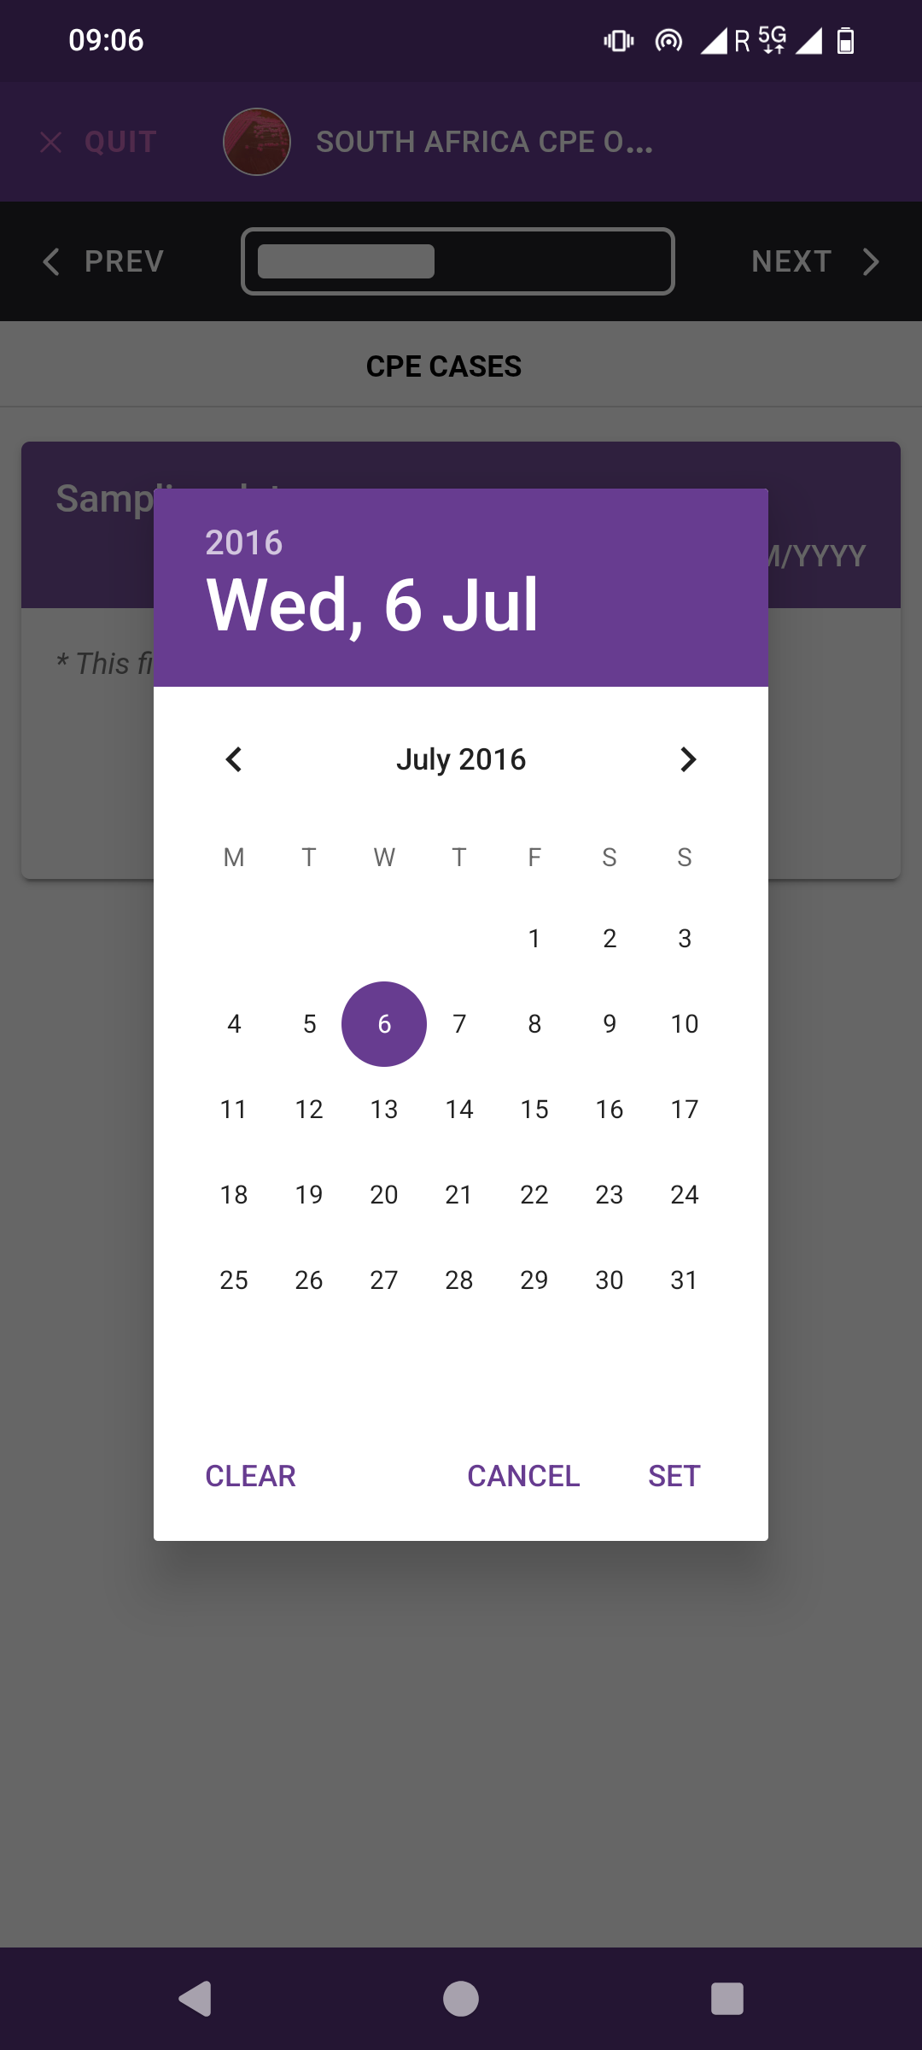
- Introduce the sample type and the sampling date of your CPE case.
Select year first

Slide 13
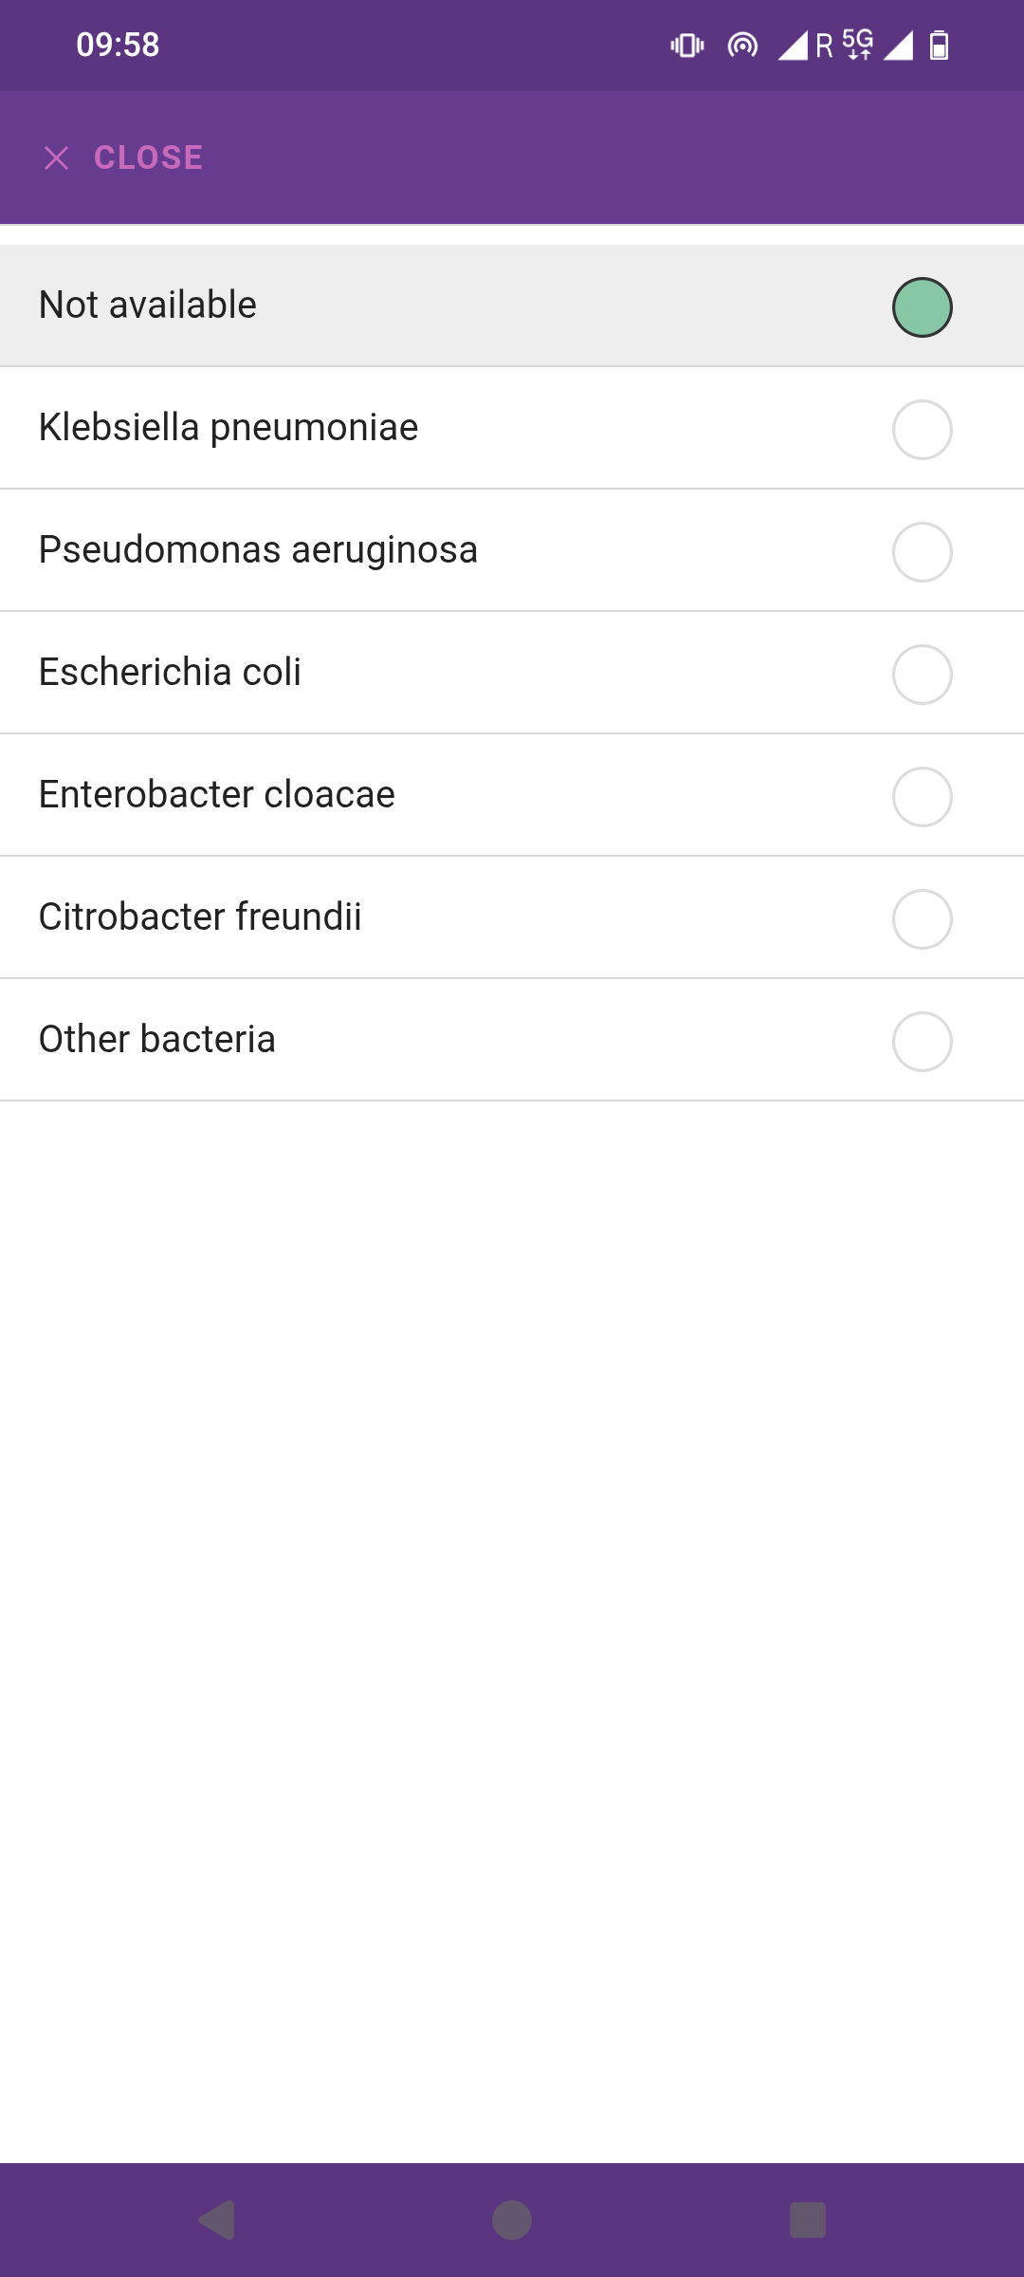
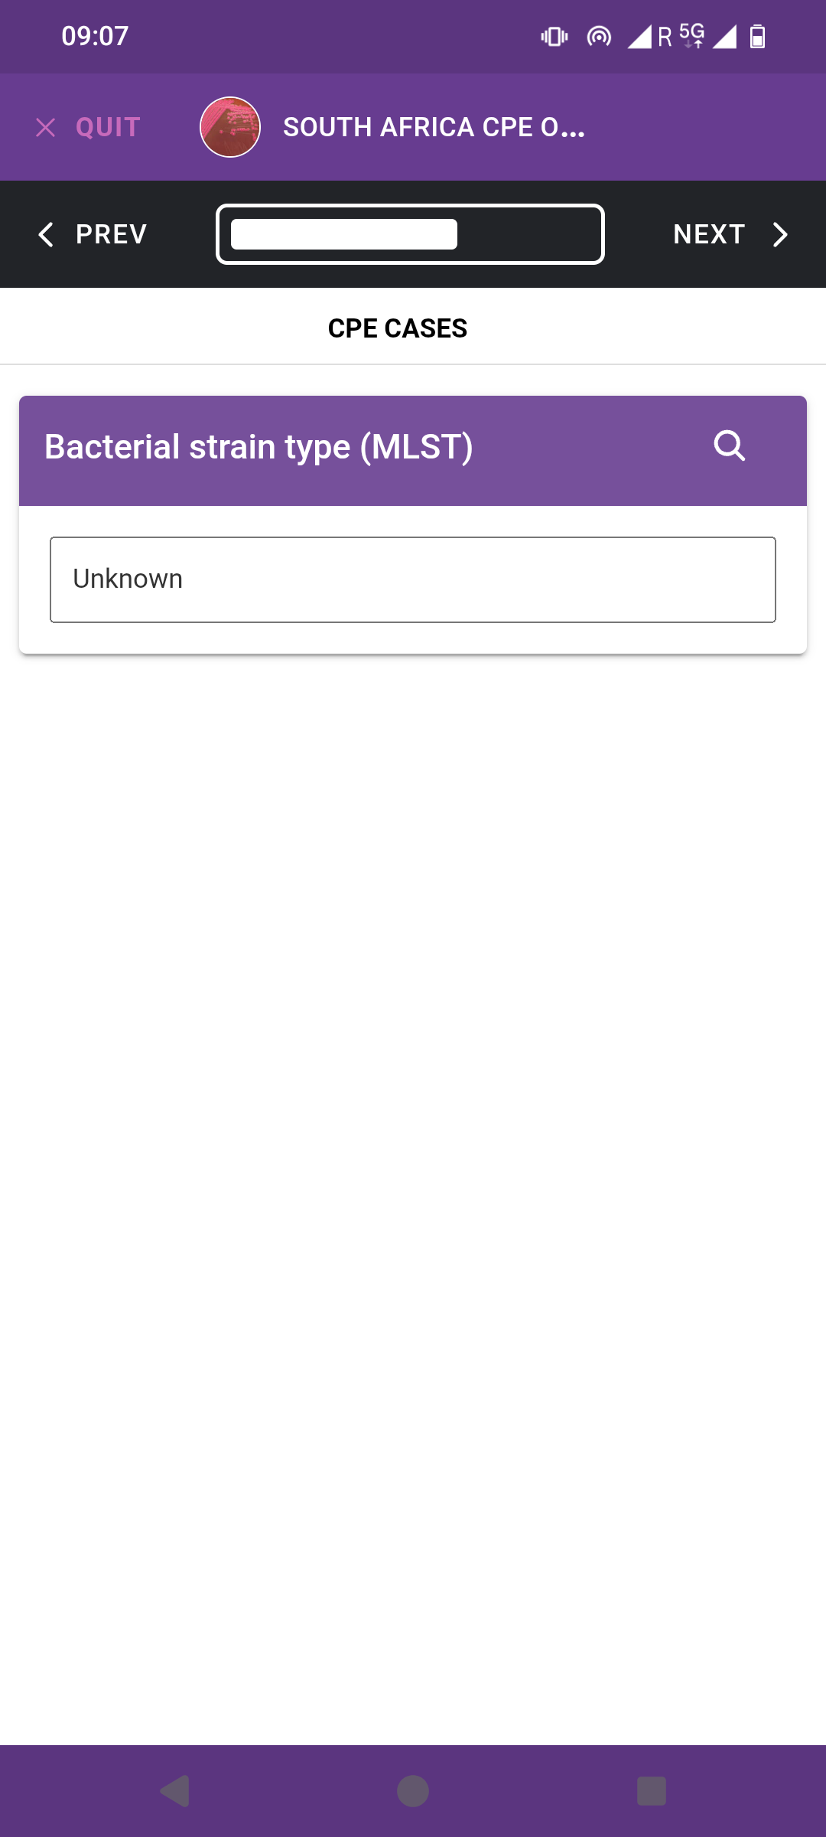
- For fields without information, select ‘Not available’ or write ‘Unknown’.

Slide 14
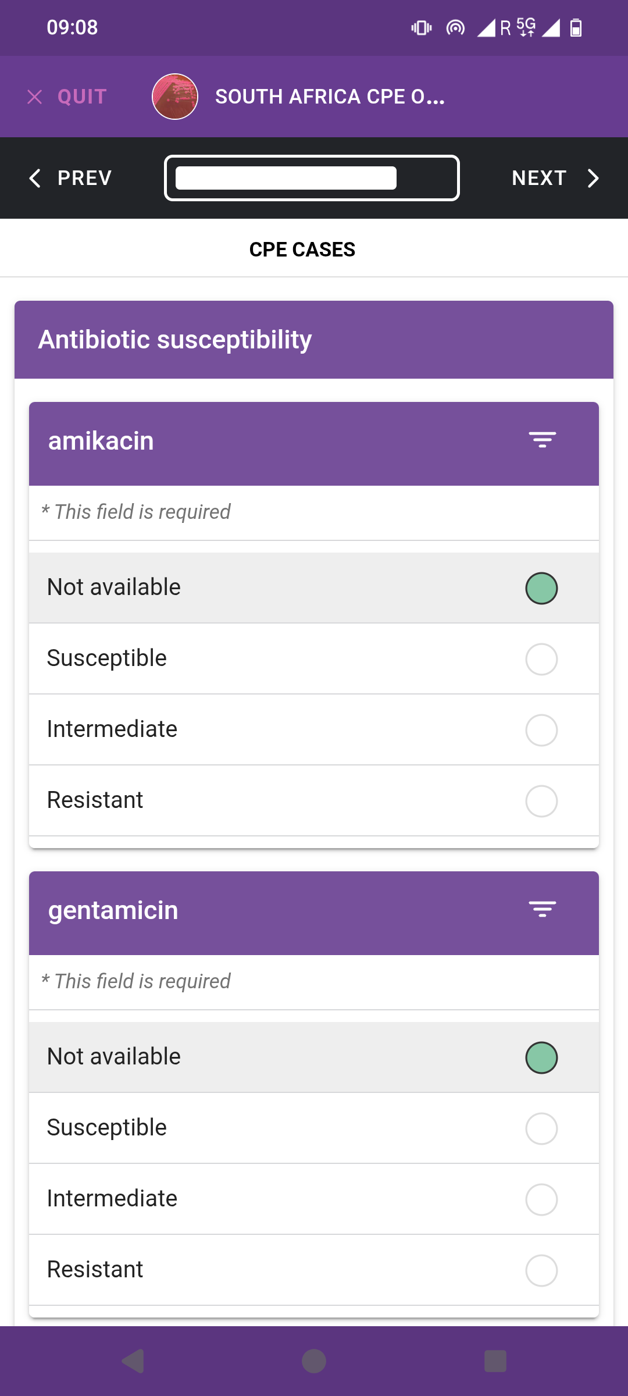
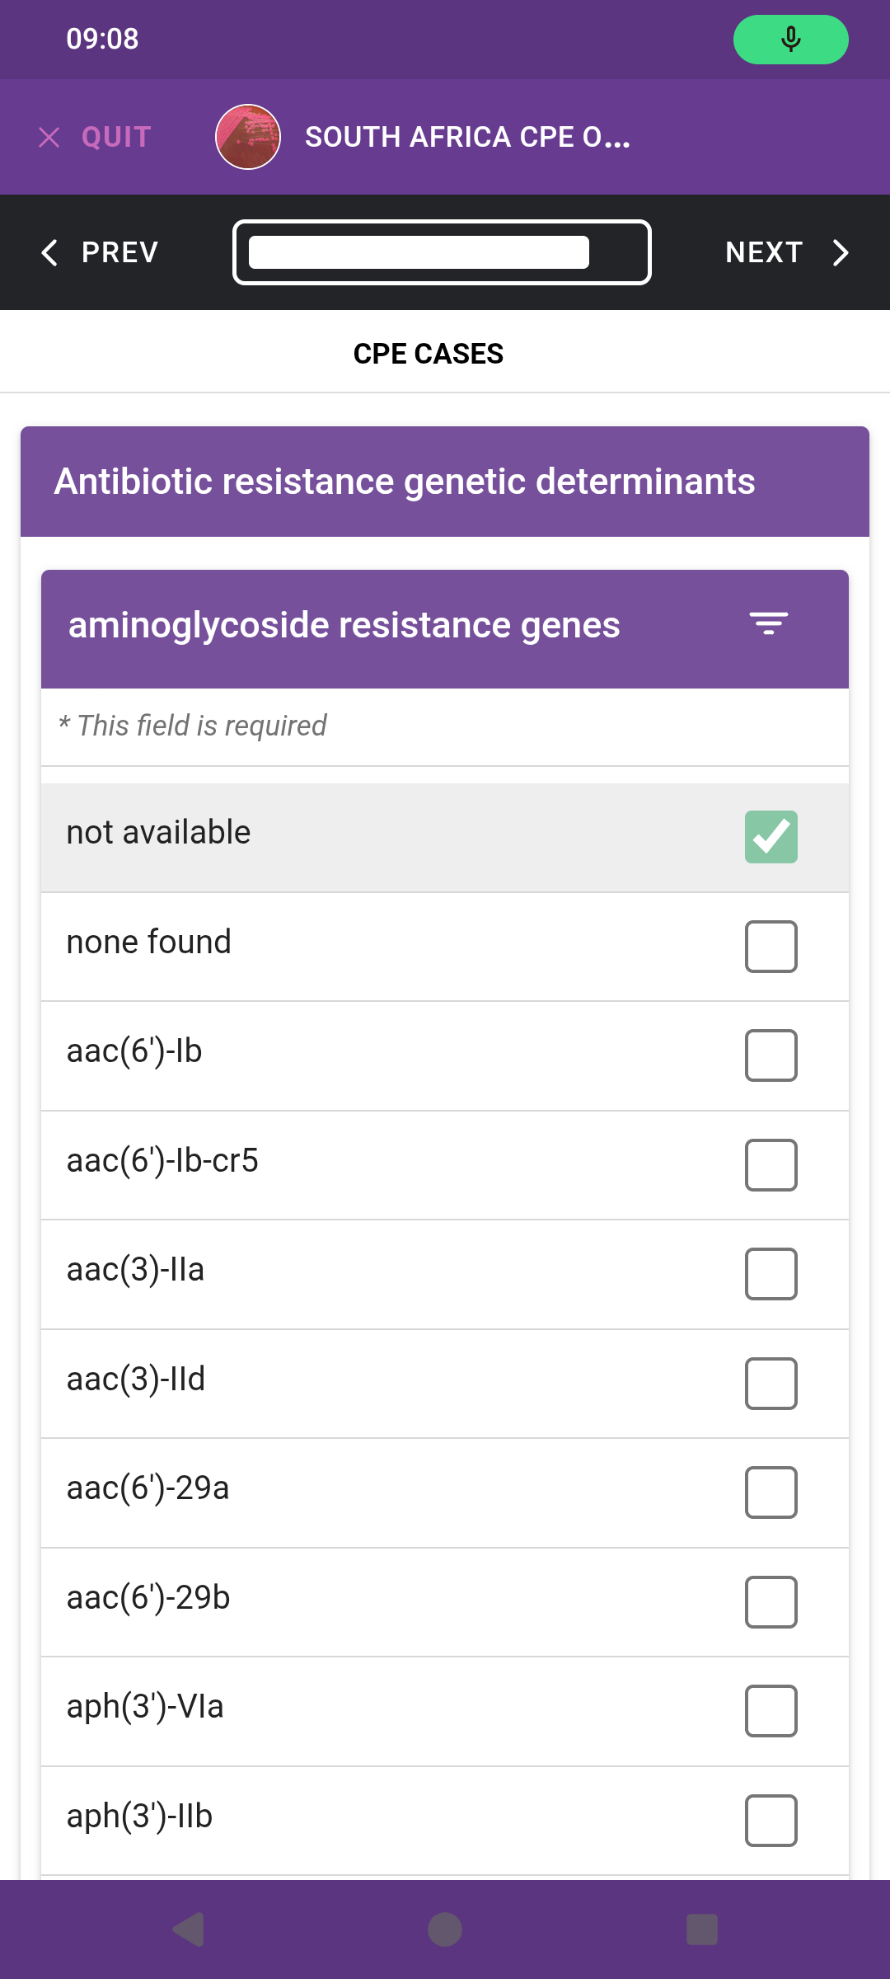
- Select ‘Not available’ for AST and AMR genes.

Slide 15
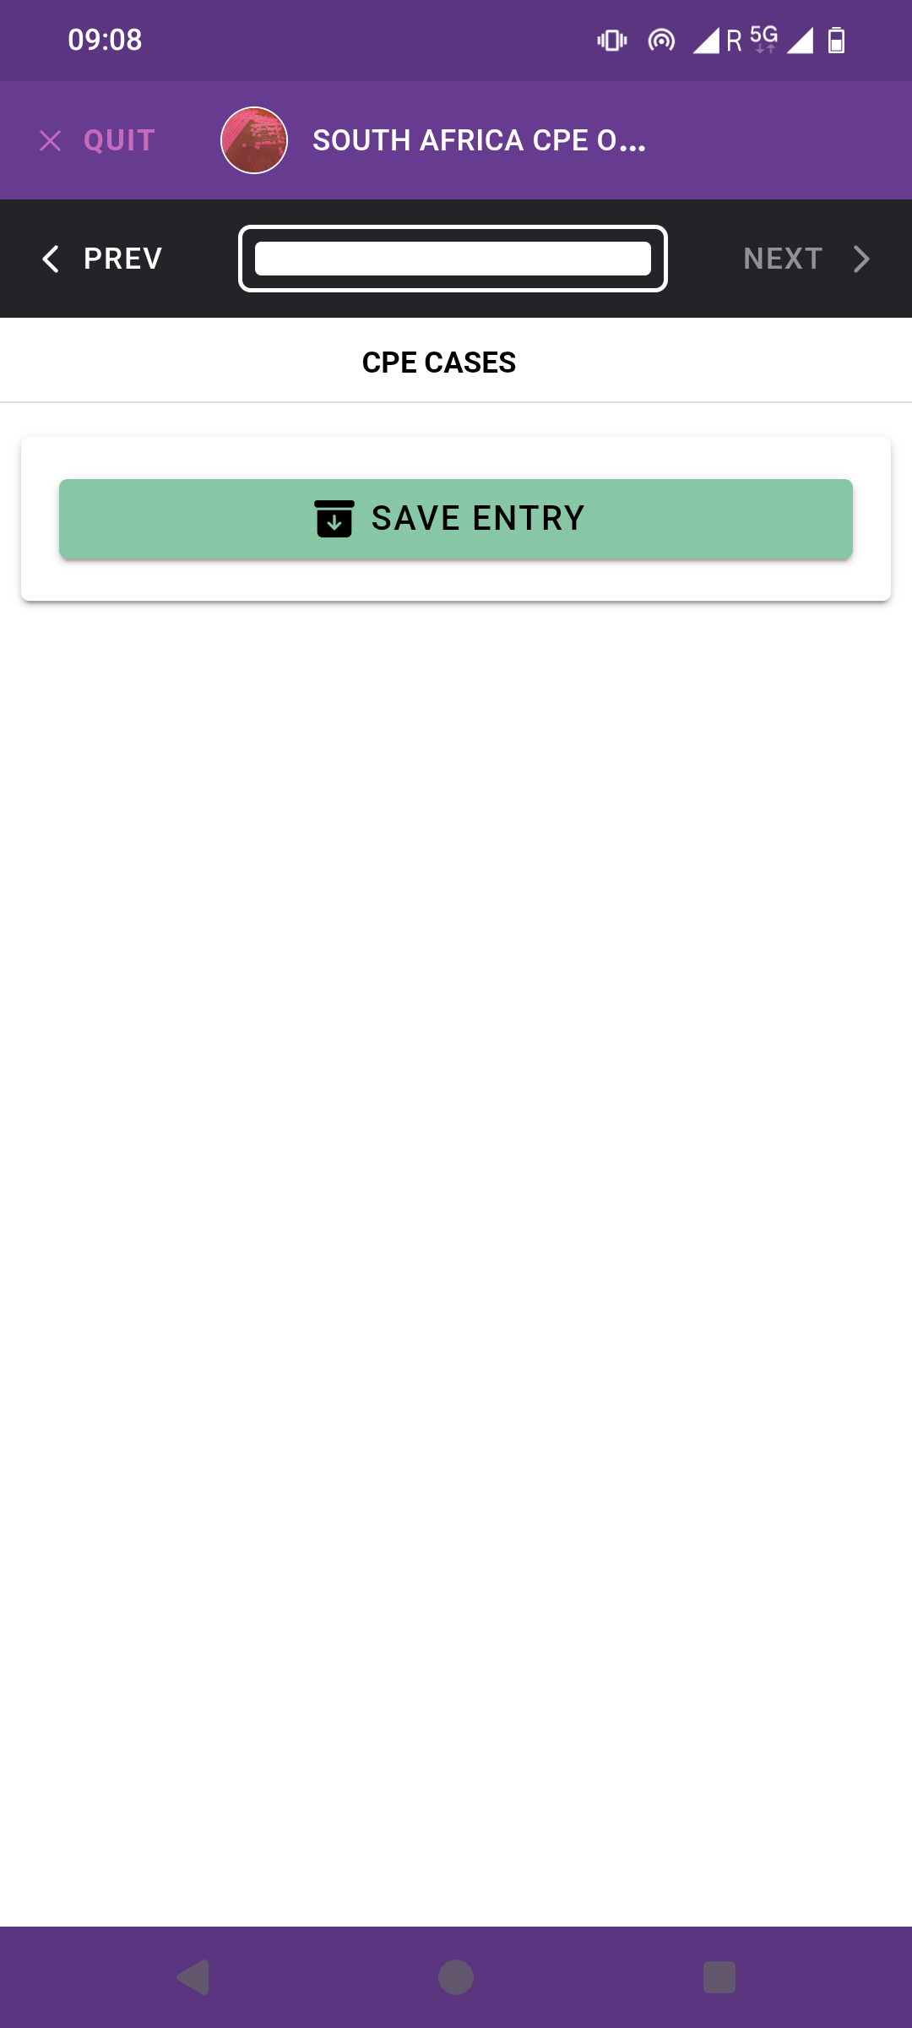
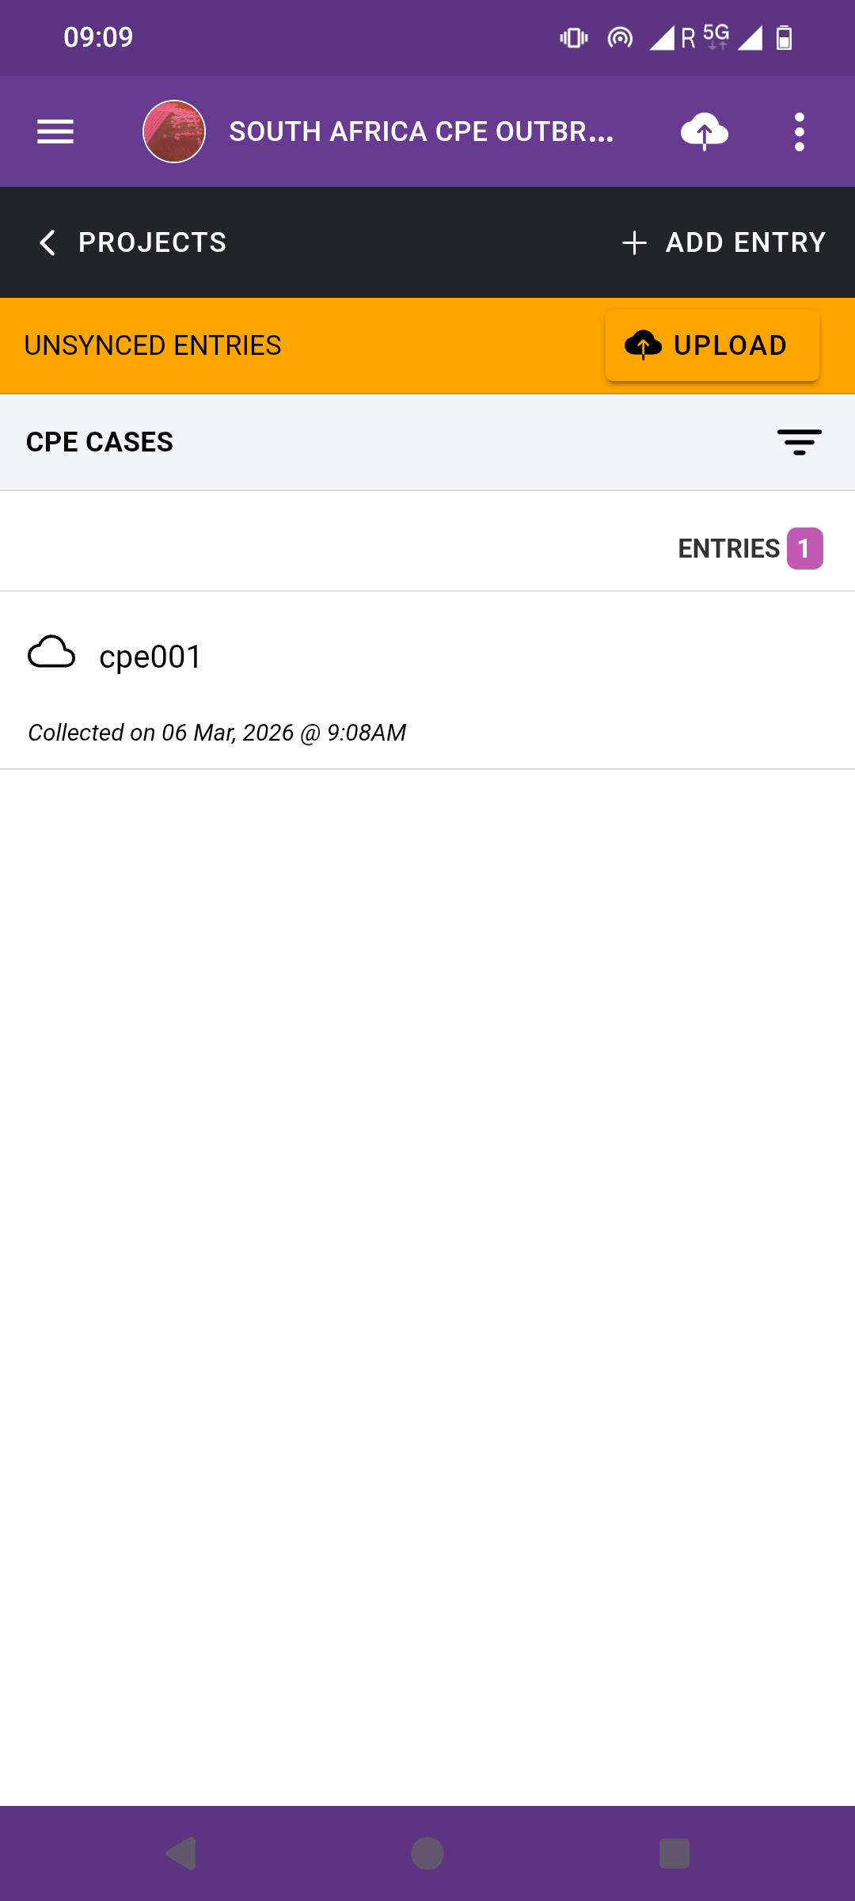
- Make sure you click on ‘Save entry’ and ‘Upload’.

Slide 16

Group 1 (n=8) Group 2 (n=8) Group 3 (n=8)
Bawa Boya |  | Tesfay Abreha Nigusse |  | Palesa Khotso
Mapeesho Kamayani |  | Rungano Magadu |  | Nelson Malugu
Winnifred Akello |  | Charles Ogu |  | Alimatou Héma
Purity Oreng' |  | Kelvin ZIngwangwa |  | Nigusu Berhanu Kassaye
Drake Byamukama |  | Ihssane Benzaarate |  | Anélsio Cossa
Lovina Ikwe |  | Mwamba Nsofwa |  | Loide Nangolo
Sulaiman Hassan |  | Rita Ohene Larbi |  | Cheickna Dicko
Deborah Jideani |  | Balungile Shezi |  | Clifford Menzi Tshuma
Go to your assigned location

Slide 17
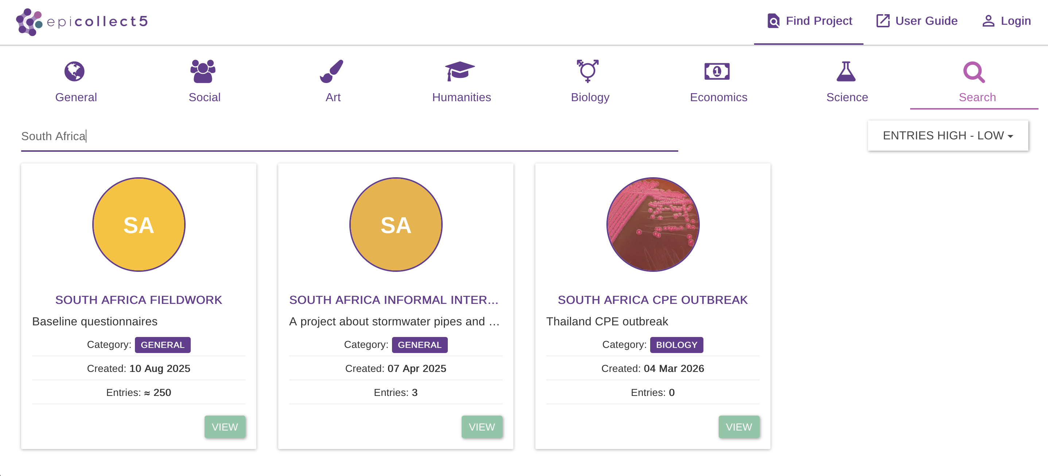
Search for ‘Thailand CPE outbreak’ EpiCollect project:
https://five.epicollect.net/project/south-africa-cpe-outbreak

Slide 18
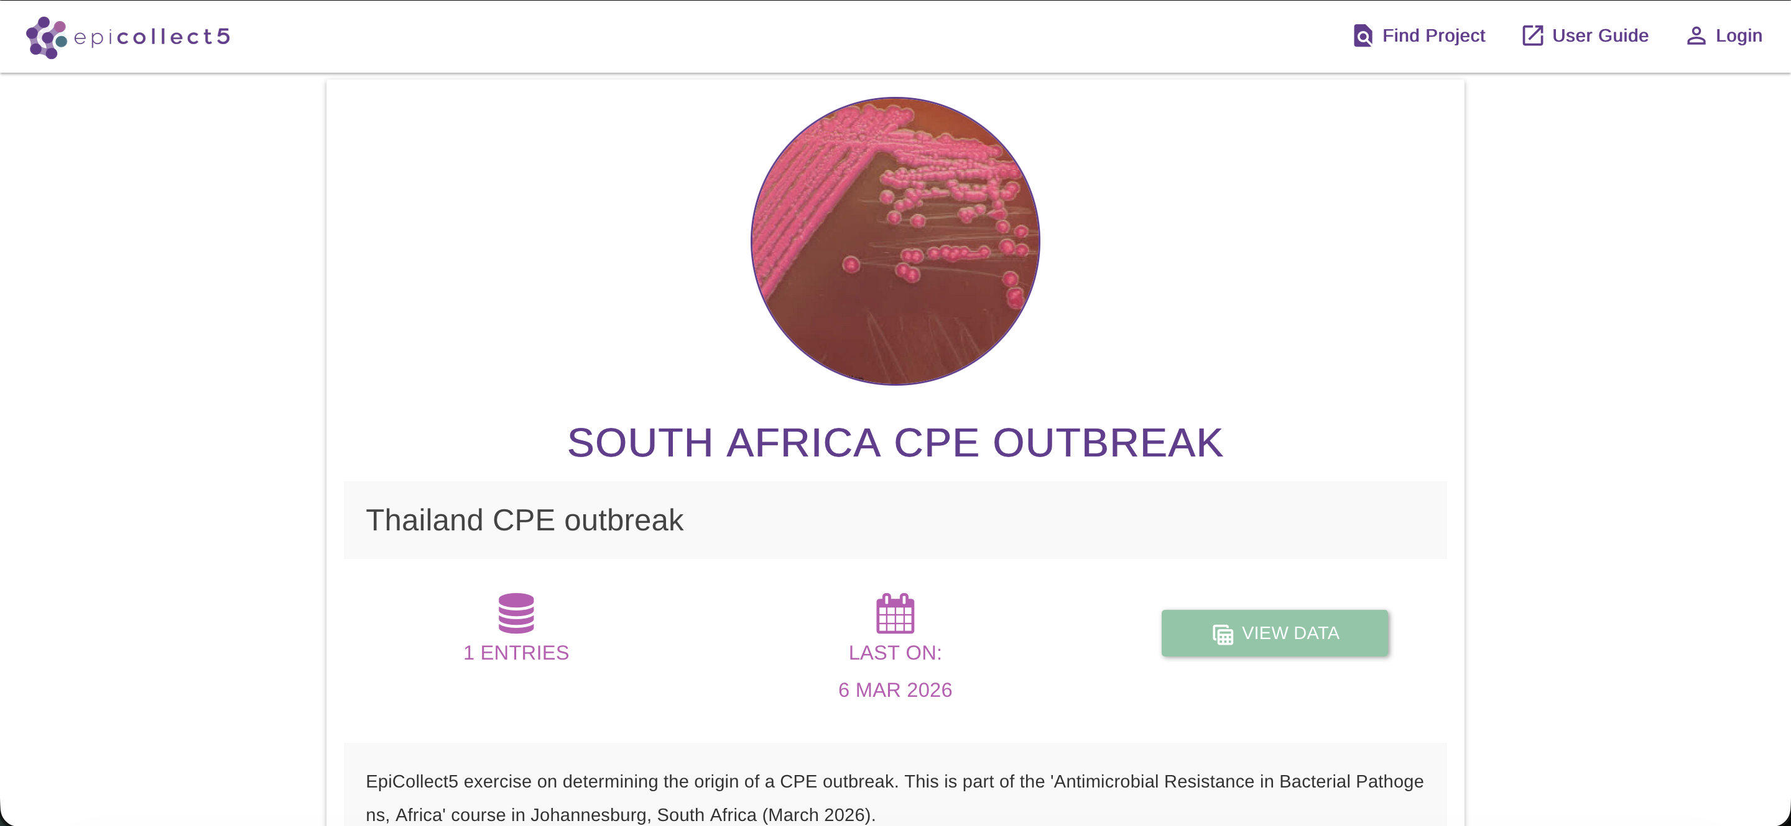
Go to:
https://five.epicollect.net/project/south-africa-cpe-outbreak
Click on the ‘VIEW DATA’ button to view collected entries

Slide 19
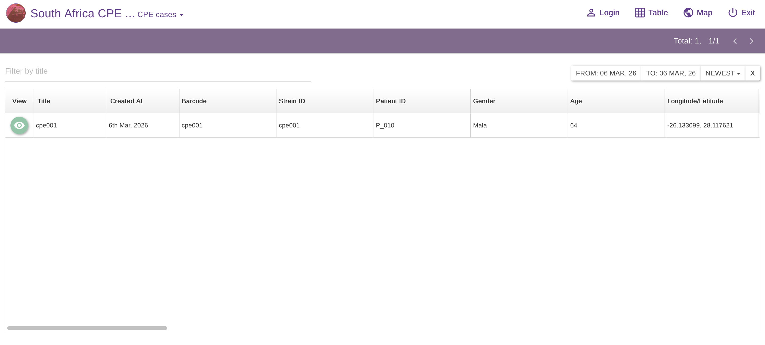
Click on the ‘VIEW DATA’ button to view collected entries

Slide 20
Click on the ‘VIEW DATA’ button to view collected entries

